Slide 1

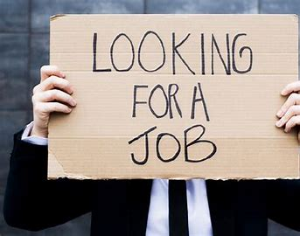




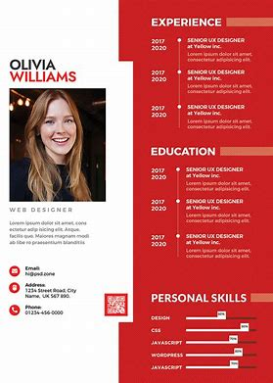
Applying for a job
Interview Skills
Agored Cymru Level 1 Certificate in Education that’s associated with Work (grade D-G)
Working in a team
Managing time
Creating a Curriculum Vitae

