Slide 1
GCSE Spanish
From 2025
Examination in 2027
Notes:
Hola. My name is Tomos Rees and I lead the Spanish department here in Plasmawr. Here is a presentation on the new Spanish GCSE course, which will be taught from September 2025.

Slide 2
Why study Spanish?
Holidays: Most popular destination for Britons.
Business: Spain and Latin America are important markets. USA is full of Spanish speakers.
Academic: MFL GCSEs are an advantage, if not a necessity, to study a degree in some universities.
Notes:
But firstly, why study Spanish GCSE? As you can see, it’s useful for travel, work and study too. A Modern Language GCSE shows any future employer that you have good cognitive skills, and the ability to learn new transferrable skills effectively.

Slide 3
Some ex-students:
“I believe that Spanish GCSE is a very fun way of extending your language skills. I remember having so much fun learning a new language with my friends, and I found the lessons to be a nice break from the rest of my schoolwork. The way Spanish is taught is engaging and I think that Spanish was one of my most enjoyable subjects during my GCSEs.”
“Spanish GCSE was one of my favourite lessons in year 10/11. By the end of the course I was able to communicate confidently in simple Spanish. Lessons were taught in an engaging way and in such a different way to the rest of my subjects. It was definitely one of my favourite lessons during my GCSEs. So much fun!”
Notes:
Here is some feedback by two ex-pupils. Although they mention fun lessons, there was a lot of hard work involved, too!

Slide 4
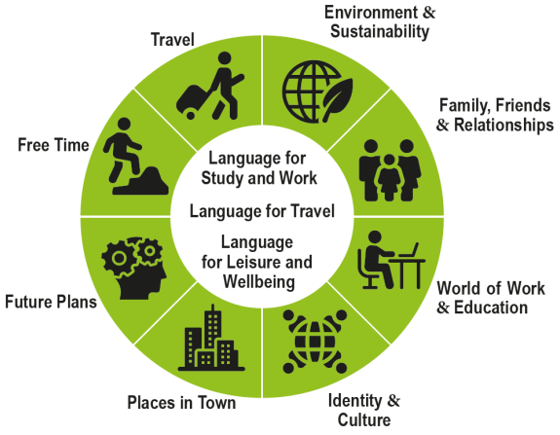
Notes:
Here are the three broad themes which cover the language we will be studying over the next two years: Language for Study and Work, Language for Travel, and Language for Leisure and Wellbeing.

Slide 5
Unit 1: Oracy 30% of the qualification (60 marks)
Non-examination assessment
Speaking test: 7-10 minutes
Preparation time: 10 minutes
Unit 2: Reading and Writing 15% of the qualification (45 marks)
Non-examination assessment: 1 hour
Unit 3: Listening 20% of the qualification (45 marks)
Written examination: 45 minutes
Uned 4: Reading and Writing 35% of the qualification (70 marc)
Written examination: 1 hour 30 minutes
Learners are not permitted to use a dictionary in any part of the assessment.
Tair tasg:
• Read aloud and role play
• Presentation and dicussion
• Conversation
• Written response in Spanish
• Listening comprehension tasks with fixed and written responses
• Reading comprehension tasks
• Translation from Spanish into Cymraeg/English
• Writing tasks in response to simple and familiar stimuli
Notes:
At the end of Year 11, this is how the language will be assessed. As you can see, forty five percent of the final grade will now be non-examination assessments.

Slide 6
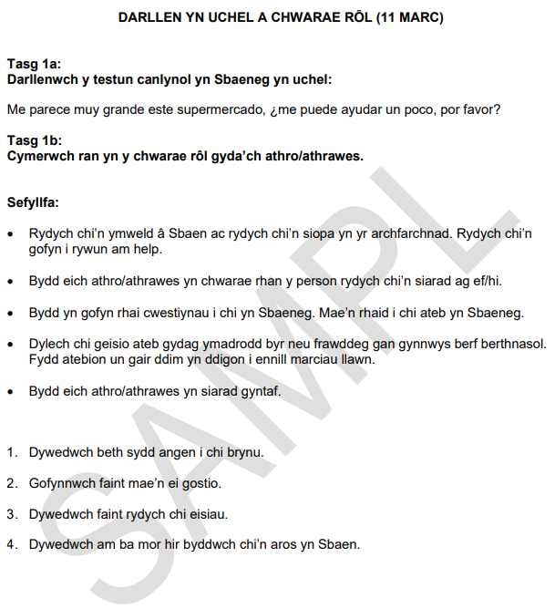
Llafaredd (30% of the qualification)
Speaking test: 7-10 minutes
Preparation time: 10 minutes
3 tasks:
• Read aloud and role play (in different settings including the following: train station; tourist office; cinema; hotel; doctor’s surgery; shops) [2 minutes].
• Presentation [1 minute] and discussion [2-3 minutes]
• Conversation [2-4 minutes]
An oral presentation, communicating information, on a subject of the learner’s choosing which falls within one of the following three broad themes; take part in an unprepared discussion relating to the presentation lead by the teacher. The presentation may be prepared two weeks in advance of the first timetabled assessment.
Candidates will contribute to a conversation based on one of the 3 broad themes. The conversation should be based on a different broad theme to the one chosen for the presentation.
Notes:
The oral assessment will be conducted around the end of the second term of Year 11. The assessment will start with a role-play as before, but this time it will happen in a practical context. The second part will be a presentation of the student’s choice, followed by questions from the teacher. Part three will a conversation on a different theme to the two previous parts

Slide 7
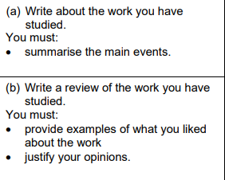
Reading and Writing (15% of the qualification)
1 hour
The assessment will take place during an eight-week period between March and May, specified annually by WJEC. Centres may download the task three working days in advance of the first assessment.
Learners will complete one task. The task requires learners to complete a response with a maximum of 200 words (task (1a), 70 words and task (1b) 130 words) in Spanish.
This task requires learners to respond to a task in Spanish, based on the study of the chosen work, for example:
graphic novel, short story, film script or novel
Notes:
This specification’s innovation is the study of literature. Pupils will be expected to write approximately two hundred words on the work studied of the previous two years- which will probably be a short story.

Slide 8
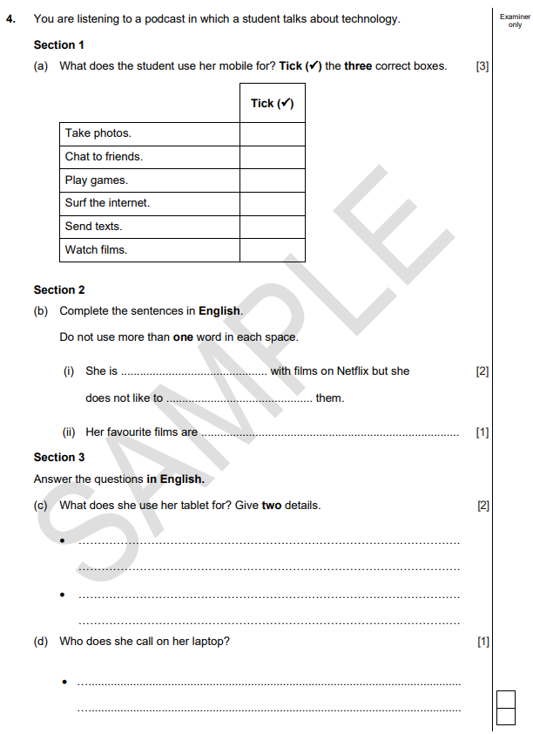
Gwrando (20% of the qualification)
Written examination:
45 minutes (including 5 minutes reading time)
The rubrics will be in Cymraeg/English.
Notes:
The Listening examination will be conducted in May or June, when students will listen to each fragment twice only.

Slide 9
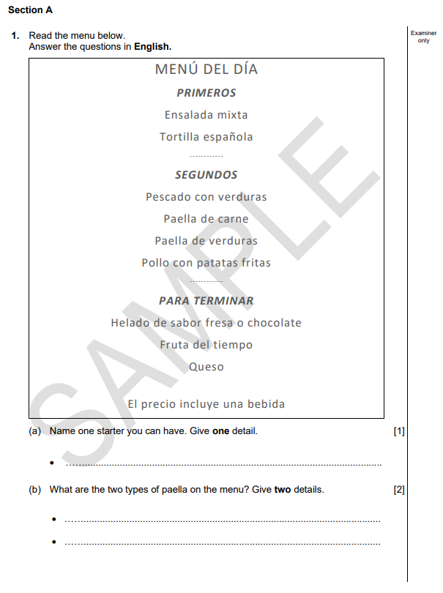
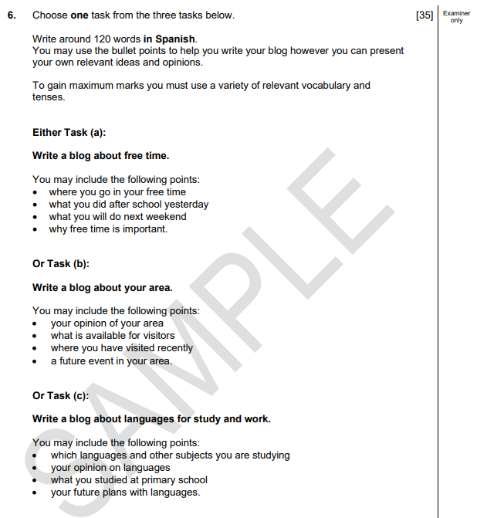
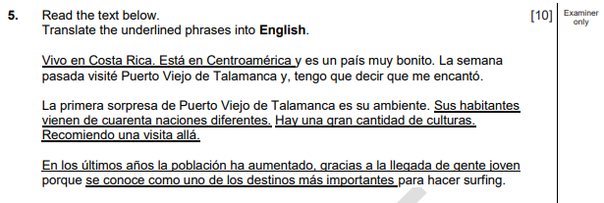
Reading and Writing (35% of the qualification)
4 comprehension questions
1 translation from Spanish
1 writing question of around 120 words (a choice from the 3 broad themes).
Notes:
And again, in May or June, the Reading and Writing examination will be conducted, which contains Reading Comprehension questions, Translation and a Written question based on one of the three broad themes.

Slide 10
Hola a Jason Isaacs
Notes:
As previously mentioned, Spanish lessons are engaging and can be fun, but in order to fulfill their potential, it’s essential that learners work at learning Spanish vocabulary and structures outside the classroom as well.

