Slide 1
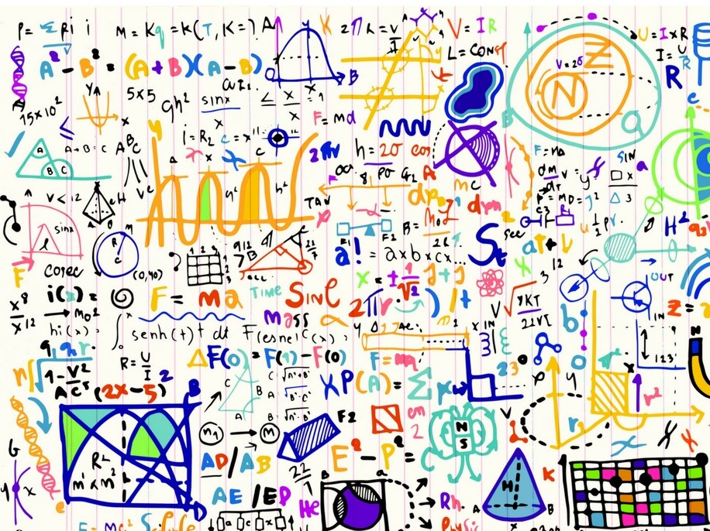
An introduction to GCSE Mathematics and Numeracy (Double award)
There are two tiers of entry for this qualification::
Higher Tier (A* - D)
Foundation Tier (C – G)
Learners may be entered at different tierd across units.

Slide 2
Assessment:
GCSE Mathematics and Numeracy (Double award)
100% exam – No coursework
Unit 1: Financial Mathematics and Other Applications of Numeracy
(Calculator will be allowed) 30% of qualification
Unit 2: Non-calculator
30% of qualification
Unit 3: Calculator-allowed
40% of qualification

Slide 3
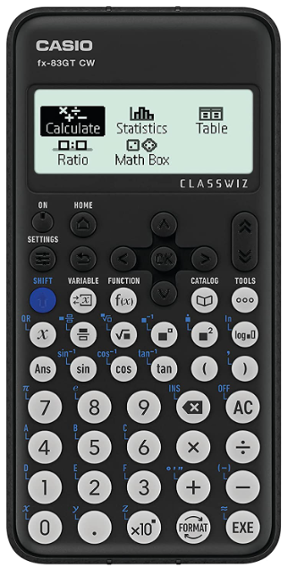
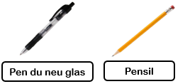
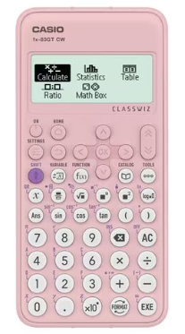
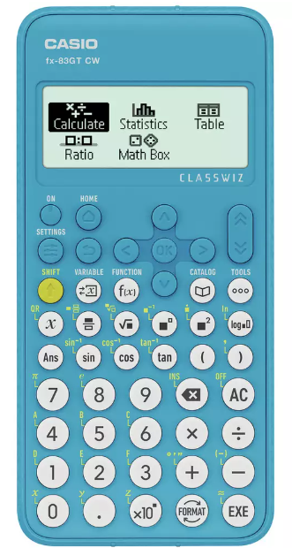
GCSE Mathematics and Numeracy
(Double award)
Necessary equipment:
Casio fx-83GT

Slide 4
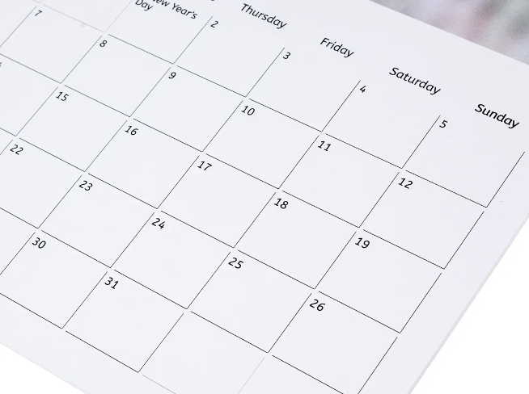
When?
Possibility of external exams with various units:
Summer Year 10
November Year 11
Summer Year 11

Slide 5
Aims
The construct of GCSE Mathematics and Numeracy (Double Award) is based on the five interdependent proficiencies that make up the Curriculum for Wales’ principles of progression for the Mathematics and Numeracy Area:
conceptual understanding
communication using symbols
fluency
logical reasoning
Strategic competence
And the content based on the mathematical and numerical concepts:
number
algebra
geometry and measures
statistics and probability

Slide 6
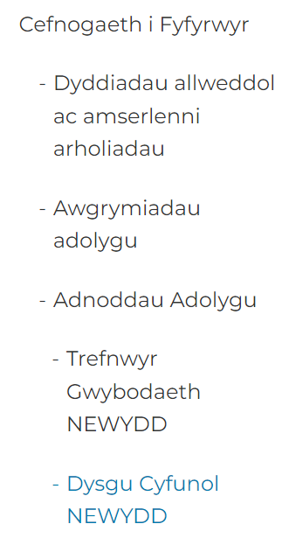
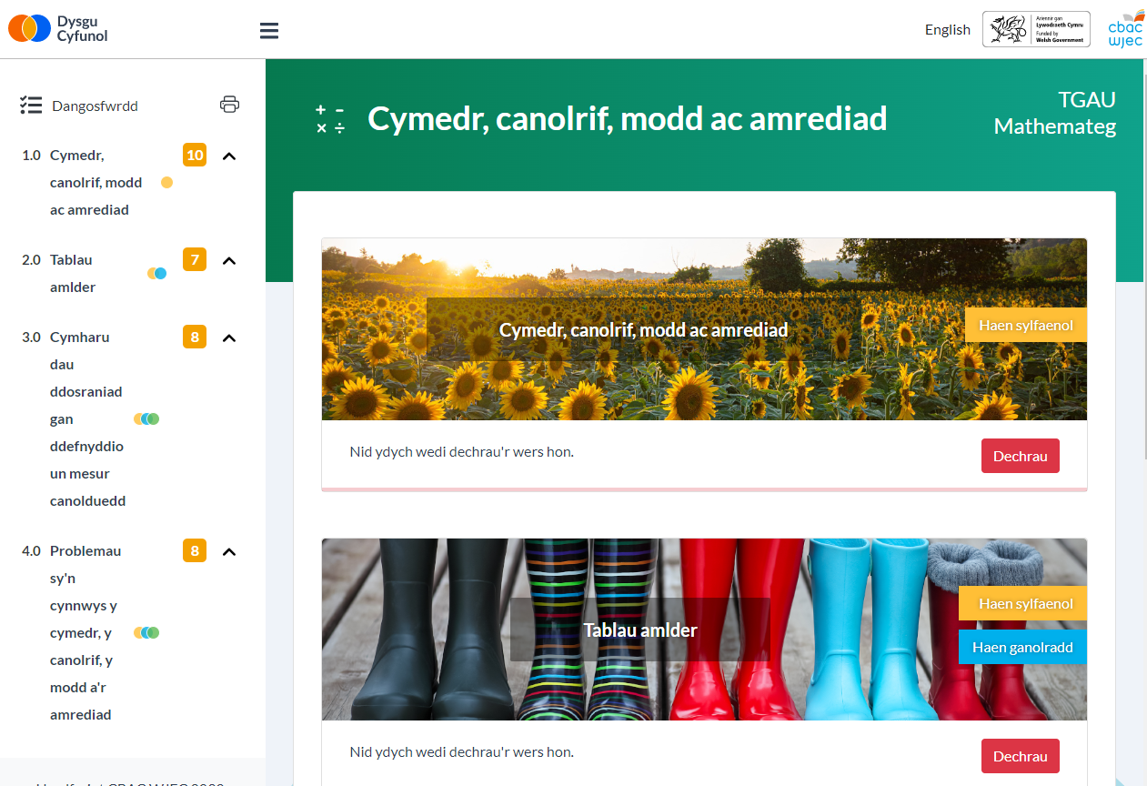
Help?
WJEC Blended Learning

Slide 7
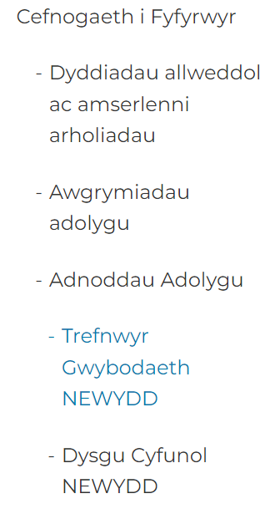
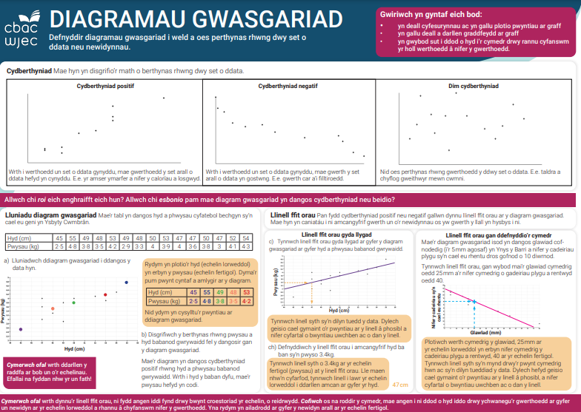
Help?
WJEC Knowledge Organisers

Slide 8
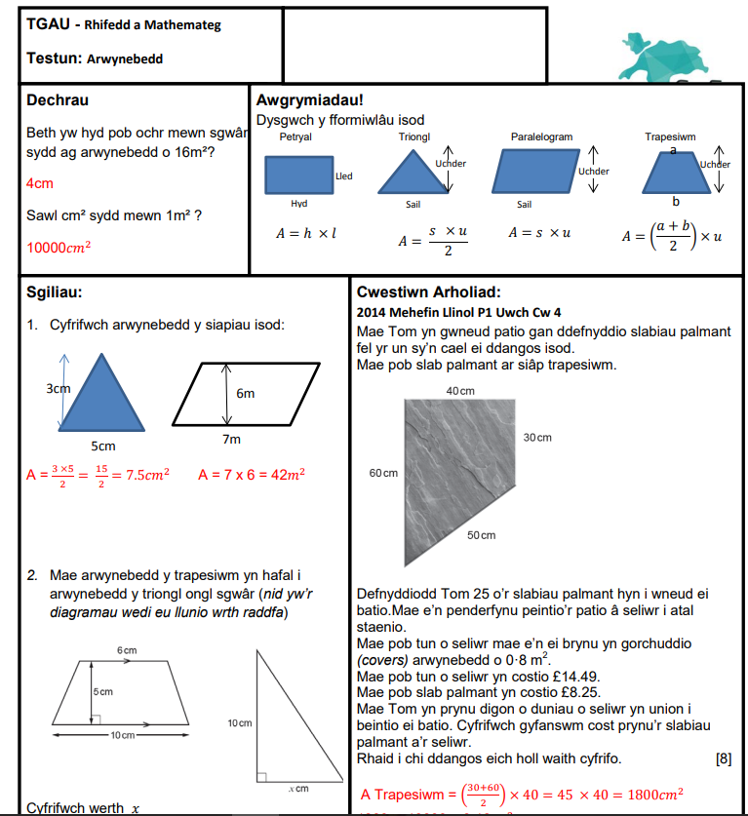
Help?
Maths.cymru

Slide 9
Help?
Mathemateg.com

Slide 10
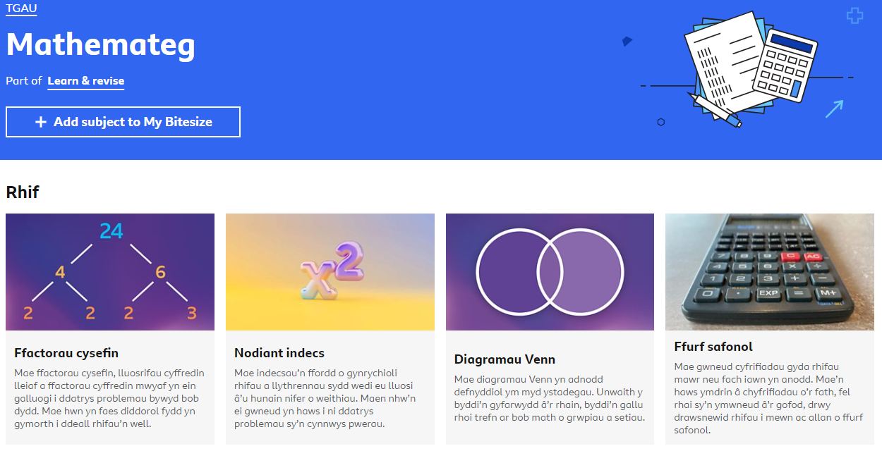
Help?
BBC Bitesize

Slide 11
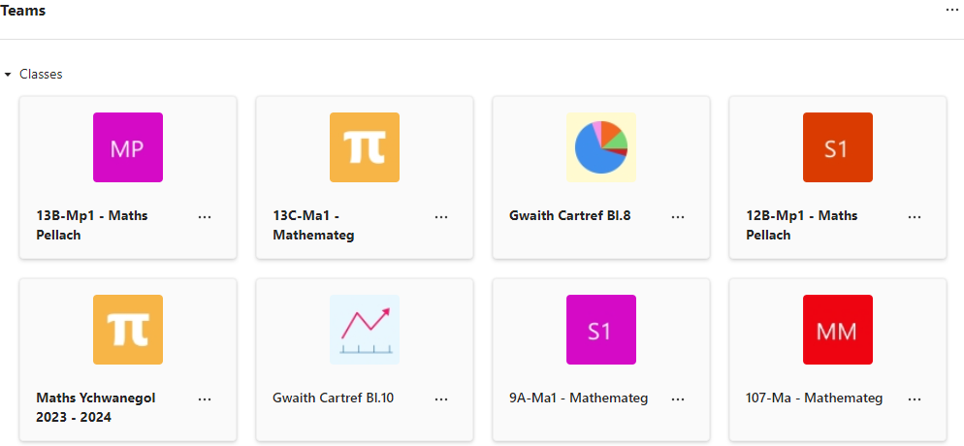
Help?
School teams

